Slide 1
Examples

Slide 2
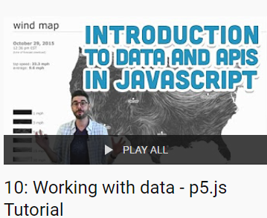
Contents
https://www.youtube.com/playlist?list=PLRqwX-V7Uu6a-SQiI4RtIwuOrLJGnel0r
Camera
Weather
News feed NYTime
Music player
https://editor.p5js.org/Zipexpo/sketches/vIcRDNmAa
https://editor.p5js.org/Zipexpo/sketches/a0txcOe-8
https://editor.p5js.org/Zipexpo/sketches/lZdpjJSYS
https://editor.p5js.org/Zipexpo/sketches/Kr2_gOl5C

Slide 3
CAMERA
https://editor.p5js.org/Zipexpo/sketches/vIcRDNmAa

Slide 4
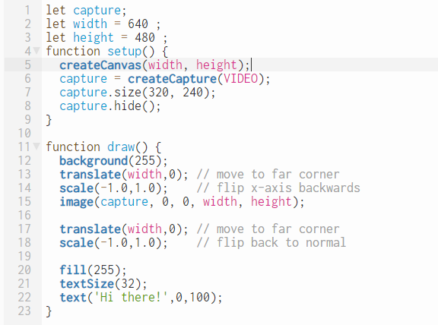
CAMERA
https://editor.p5js.org/Zipexpo/sketches/vIcRDNmAa
Setup camera
Flip camera
Flip canvas back to normal

Slide 5
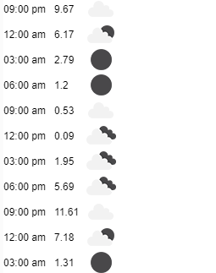
Weather
https://editor.p5js.org/Zipexpo/sketches/a0txcOe-8

Slide 6
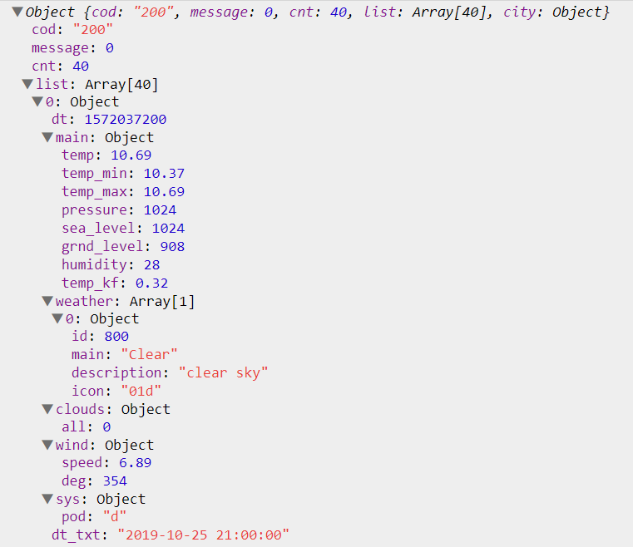
WEATHER
https://editor.p5js.org/Zipexpo/sketches/a0txcOe-8
Temperature
Weather Icon
Date and Time

Slide 7
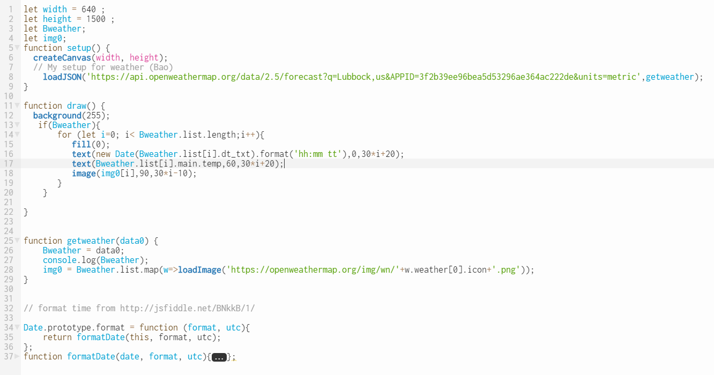
WEATHER
https://editor.p5js.org/Zipexpo/sketches/a0txcOe-8
Load weather
Draw detail
Format time
Get temperature
Load weather icon
Assign data and load image

Slide 8
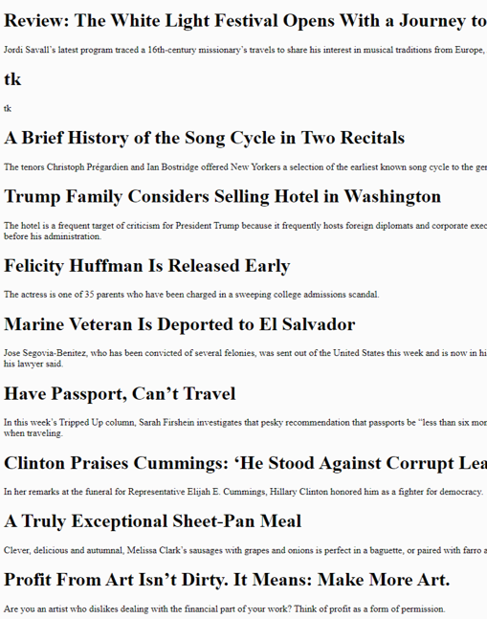
NYTIME
https://editor.p5js.org/Zipexpo/sketches/lZdpjJSYS

Slide 9
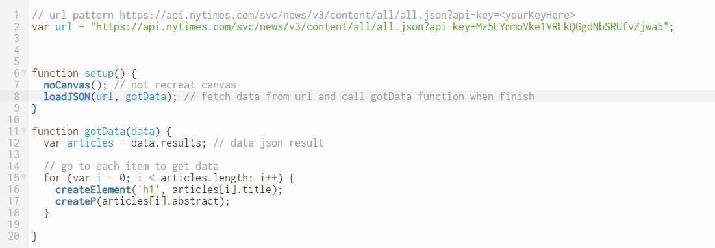
NYTIME
https://editor.p5js.org/Zipexpo/sketches/lZdpjJSYS
Sign In
Choose API
Get API Key
Get API URL

Slide 10
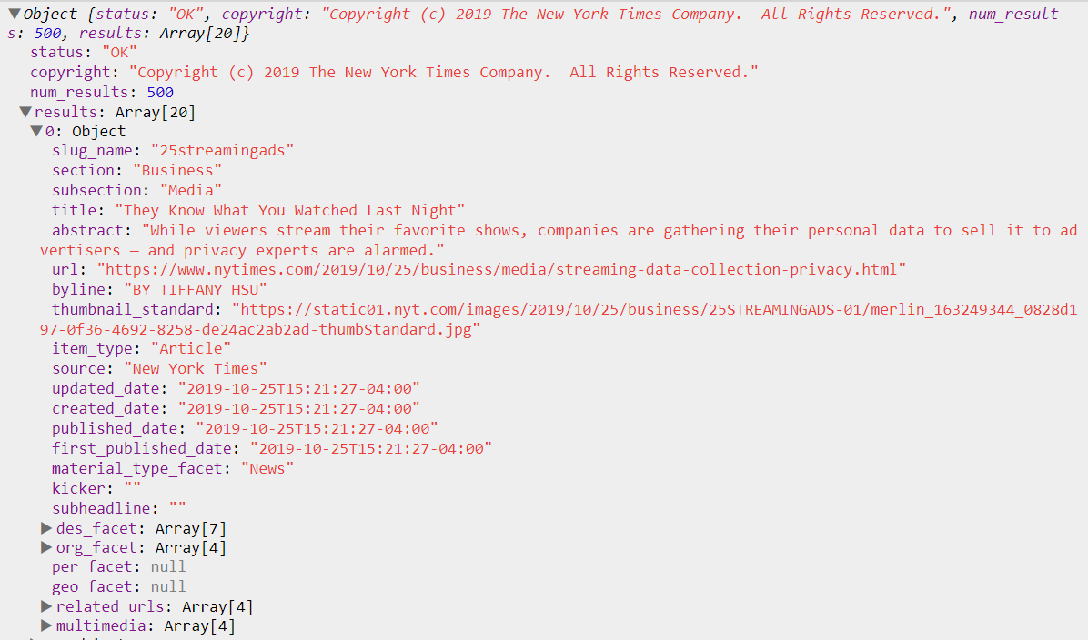
NYTIME
https://editor.p5js.org/Zipexpo/sketches/lZdpjJSYS

Slide 11
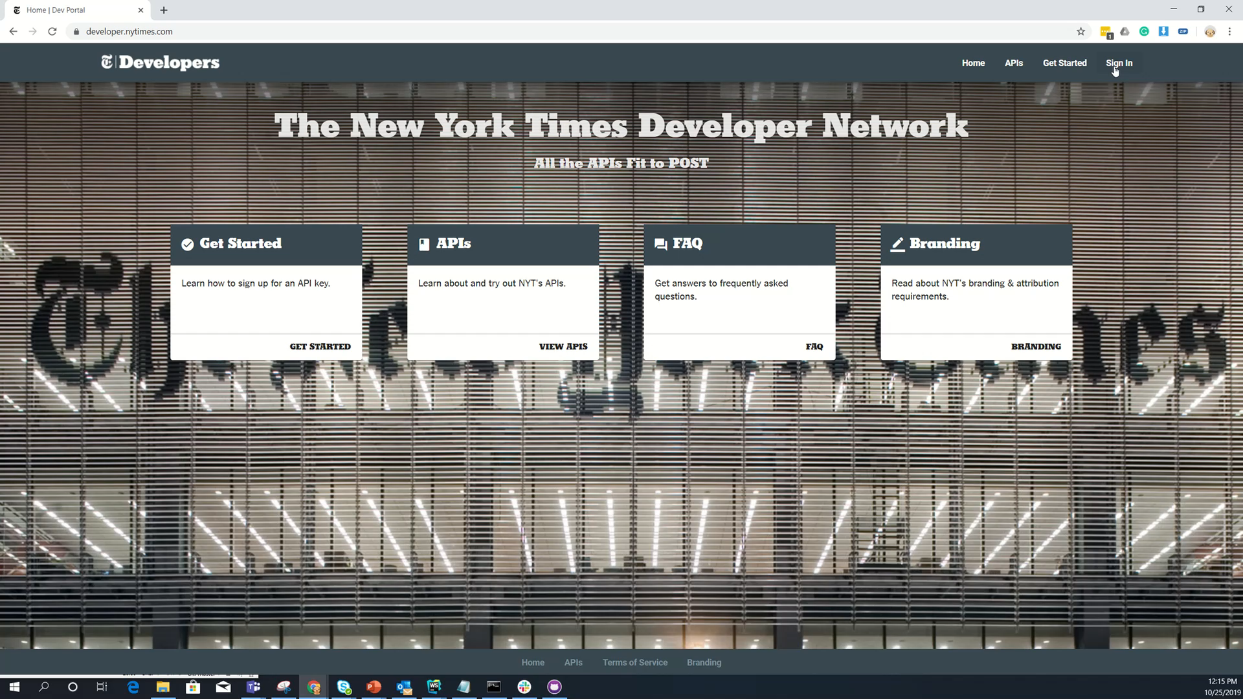
NYTIME
https://editor.p5js.org/Zipexpo/sketches/lZdpjJSYS
How to sign in and get API key
https://developer.nytimes.com

Slide 12
NYTIME
https://editor.p5js.org/Zipexpo/sketches/EJRN1Zwu8
with style

Slide 13
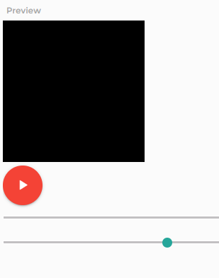
Music player
https://editor.p5js.org/Zipexpo/sketches/Kr2_gOl5C

Slide 14
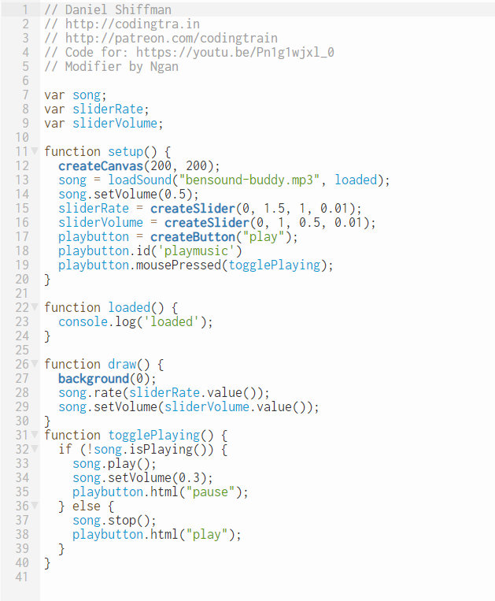
MUSIC PLAYER
https://editor.p5js.org/Zipexpo/sketches/Kr2_gOl5C

Slide 15
MUSIC PLAYER
https://editor.p5js.org/Zipexpo/sketches/UyqyAJXjr
https://521dimensions.com/open-source/amplitudejs

Slide 16

THANK YOU
Ngan.V.T.Nguyen@ttu.edu

